Slide 1
Oracle Application Express (APEX)
Project Implementation for
COSC 5050 Distributed Database Applications
Lab4

Slide 2
Creating APEX Forms
Creating form
Running form from a report
Customizing form
Region attributes
Page appearance
Show and hide region, conditional region, hint region
Item attributes
Display only text fields
List of values (LOV)

Slide 3
Oracle APEX Form
Forms are user interfaces that enable data manipulation
A number of wizards can be used to create forms automatically or manually
Data and form elements are placed in regions
Region attributes control region placement and positioning
Item attributes control the placement and style of form elements (items) inside of regions

Slide 4
Working with Form
Creating a table and data input form
Running the form with a report
Changing the appearance of a page by altering region attributes
Making region conditional
Adding a region to contain hint text
Changing item types to LOV

Slide 5
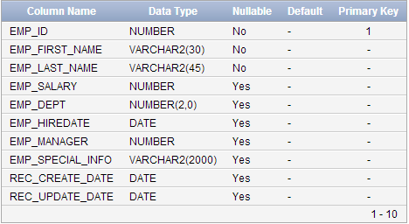
Creating Table HT_EMP
Create the HT_EMP table
Include table, sequence, triggers, and data
Notes:
-- drop table HT_EMP;
-- drop sequence HT_EMP_SEQ;
CREATE TABLE HT_EMP (
EMP_ID NUMBER PRIMARY KEY,
EMP_FIRST_NAME VARCHAR2(30) NOT NULL,
EMP_LAST_NAME VARCHAR2(45) NOT NULL,
EMP_SALARY NUMBER,
EMP_DEPT NUMBER(2,0) REFERENCES DEPT(DEPTNO),
EMP_HIREDATE DATE,
EMP_MANAGER NUMBER REFERENCES HT_EMP,
EMP_SPECIAL_INFO VARCHAR2(2000),
REC_CREATE_DATE DATE,
REC_UPDATE_DATE DATE);
INSERT INTO HT_EMP
(EMP_ID, EMP_FIRST_NAME, EMP_LAST_NAME, EMP_SALARY, EMP_DEPT, EMP_HIREDATE, EMP_MANAGER, EMP_SPECIAL_INFO, REC_CREATE_DATE)
VALUES
(1,'SCOTT','TIGER',100000,20,SYSDATE,NULL,'CELL PHONE NUMBER IS XXX.XXX.XXXX HOME PHONE IS YYY.YYY.YYYY', SYSDATE);
COMMIT;
CREATE SEQUENCE HT_EMP_SEQ START WITH 2;
CREATE OR REPLACE TRIGGER BI_HT_EMP
BEFORE INSERT ON HT_EMP
FOR EACH ROW
BEGIN
SELECT HT_EMP_SEQ.NEXTVAL INTO :NEW.EMP_ID FROM DUAL;
:NEW.REC_CREATE_DATE := SYSDATE;
END;
/
CREATE OR REPLACE TRIGGER BU_HT_EMP
BEFORE UPDATE ON HT_EMP
FOR EACH ROW
BEGIN
:NEW.REC_UPDATE_DATE := SYSDATE;
END;
/

Slide 6
Creating Form Page
Create a page containing an input form
Use the existing AnyCo Corp application
Create page → Form → Form on a table or view
Table/view name: HT_EMP
Page name: HT Employee
Region title: HT Employee
Breadcrumb: Breadcrumb
Breadcrumb entry name: HT Employee
Breadcrumb parent entry: Home

Slide 7
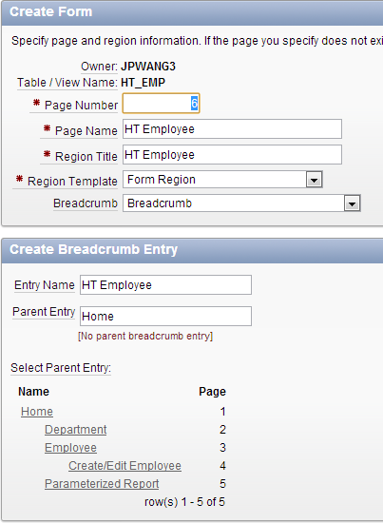
Creating Form Page

Slide 8
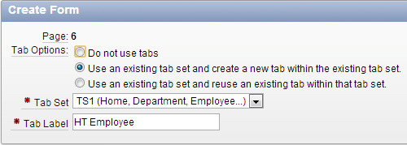
Creating Form Page
Tab options
Use an existing tab set and create a new tab within the existing tab set
Tab set: TS1 (Home, Department, Employee…)
Tab label: HT Employee

Slide 9
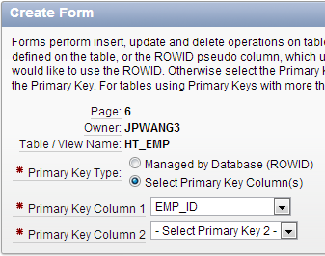
Creating Form Page
Primary key
Primary key type: Select primary key column(s)
Primary key column: EMP_ID

Slide 10
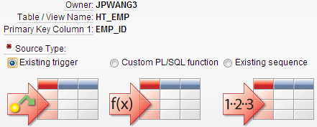
Creating Form Page
Define the source for the primary key columns
Source type: Existing trigger

Slide 11
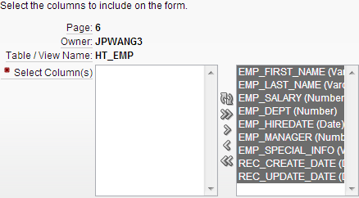
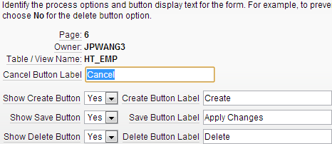
Creating Form Page

Slide 12
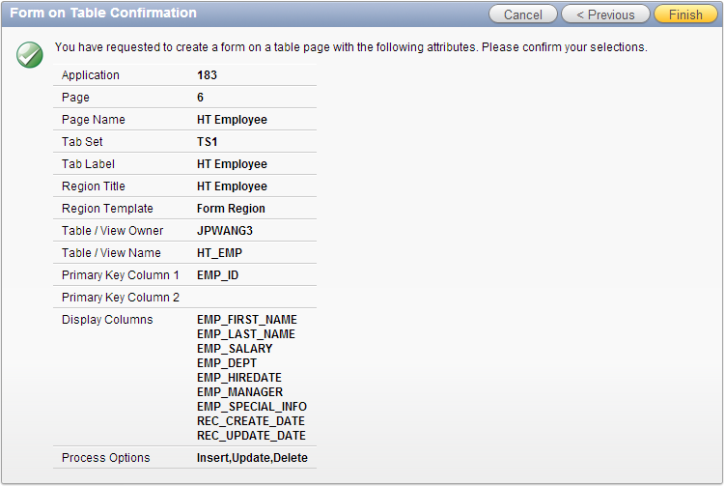
Creating Form Page

Slide 13
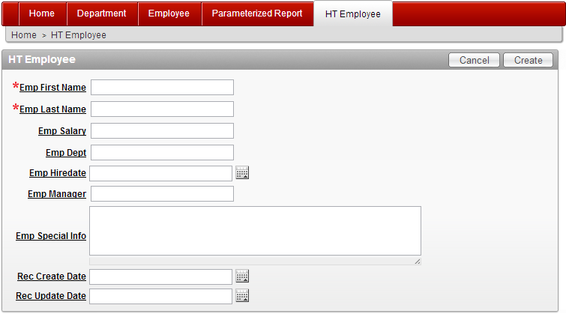
Running Form (Creating Mode)
Creating mode for insert operation
P6_EMP_ID:

Slide 14
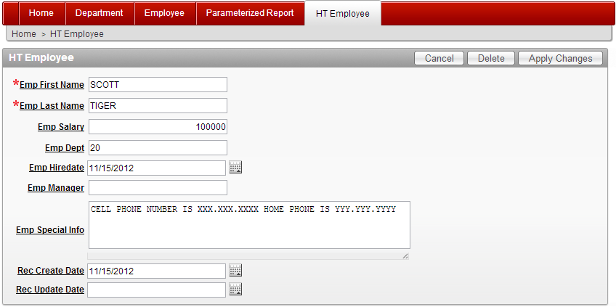
Running Form (Updating Mode)
Updating mode for delete and update operations
P6_EMP_ID:1 (with a valid value)

Slide 15
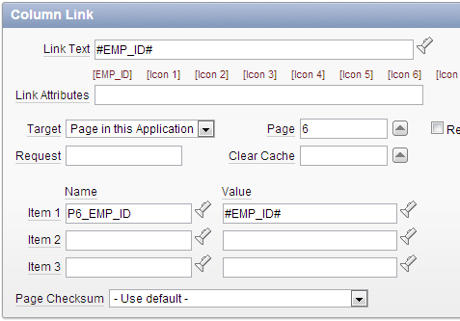
Running Form from a Report
Create an interactive report page with links to point to the form page for updating mode
Create link on EMP_ID for update and delete
Notes:
select emp_id, emp_first_name, emp_last_name, emp_salary, emp_dept, emp_hiredate, emp_manager from ht_emp;

Slide 16
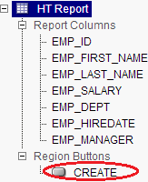
Running Form from a Report
Create a button on the report page for insert
Right click HT Report region → Create region button
Button name: CREATE
Label: Create
Position: Right of interactive report search bar
Action: Redirect to page in this application
Page: 6 (the HT_EMP form page)
Clear cache: 6
→ Create button

Slide 17
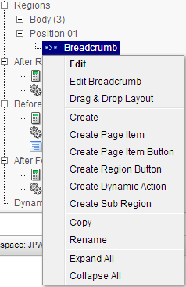
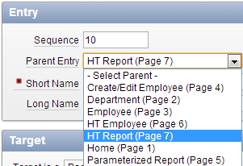
Running Form from a Report
Modify the form to return to the report page
Adjust breadcrumb, buttons, and tabs
Breadcrumb
Right click breadcrumb → Edit breadcrumb
Setting breadcrumb parent entry

Slide 18
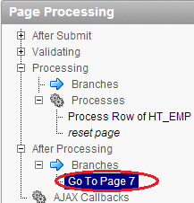
Running Form from a Report
Modify the form to return to the report page
Button cancel
Setting redirect page
Action buttons create/delete/apply changes
Edit the after processing branch

Slide 19
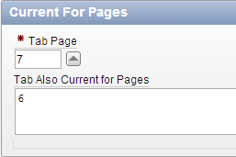
Running Form from a Report
Modify the form to return to the report page
Tabs
Shared components → Tabs → Manage tabs
Delete the tab for the form
Edit HT Report standard tab
Tab also current for pages: 6 (the form page)

Slide 20
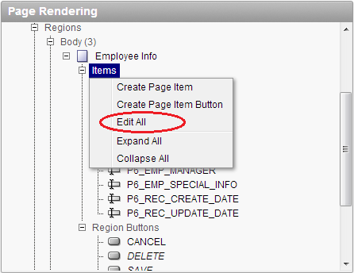
Changing Page Appearance
Change the region attributes on the form page
Edit the region title to: Employee Info
Editing Item Attributes
Change item labels
Change item width
Reorder items
Align items
Field template
Required/optional
With/without help

Slide 21
Dealing with Display Only Items
Items for audit purpose
Change audit items to display only
P6_REC_CREATE_DATE
P6_REC_UPDATE_DATE
(use your page number)
Move audit items to the newly created audit region
New region: HTML region
Title: Audit Information
Move audit items to the new region (drag & drop)
Change the region to hide/show

Slide 22
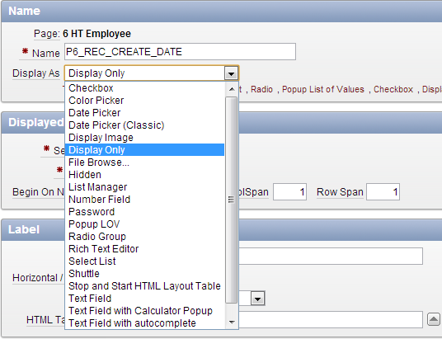
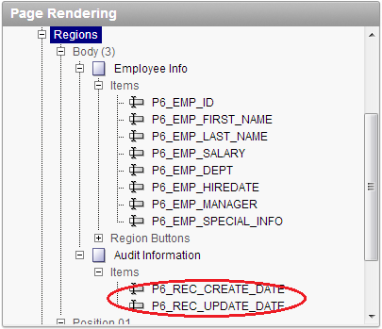
Display Only Text Field

Slide 23
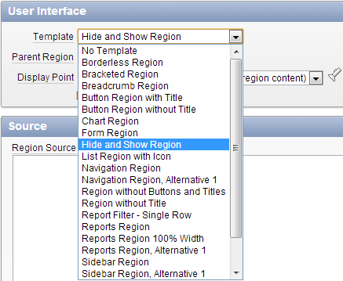
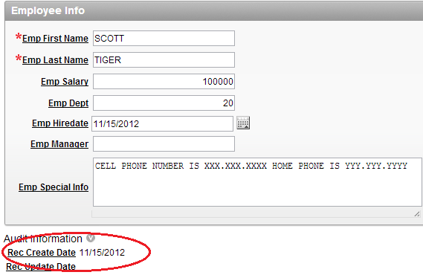
Hide and Show Region

Slide 24
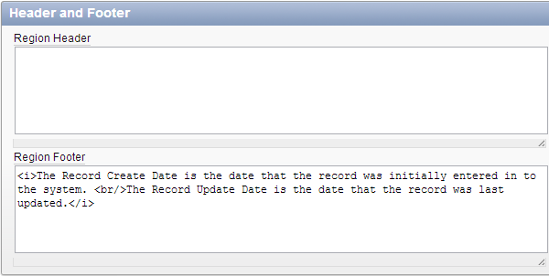
Adding Region Footer
Notes:
<i>The Record Create Date is the date that the record was initially entered in to the system. <br/>The Record Update Date is the date that the record was last updated.</i>

Slide 25
Conditional Region
Create a display condition for the Audit Information region
Display only if the Employee ID is not null
Employee ID: P6_EMP_ID (use your page number)

Slide 26
Adding Hint Text Region
Create region → HTML region → HTML
Title: Hint
Region template: Sidebar region
Display point: Page template region position 3
HTML text:
Use this page to enter and <br /> maintain employee information.
→ Create Region

Slide 27
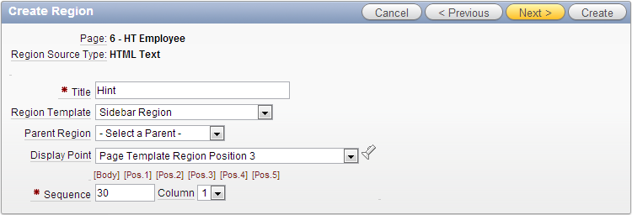
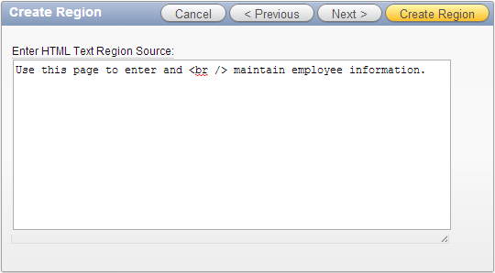
Adding Hint Text Region

Slide 28
List of Values (LOV)
A table lookup, or list of value (LOV), offers the user a list of choices from the related table
User click on the item selected and the application will store the PK from the master table in the FK field of the related table
The user never needs to know the value of the key and only sees the associated description
For example, department number and employee manager

Slide 29
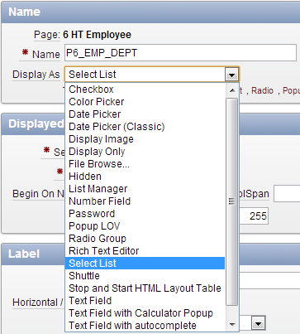
Changing Item Type to LOV
Edit item for the department (P6_EMP_DEPT)
Change item type to select list (list of values)

Slide 30
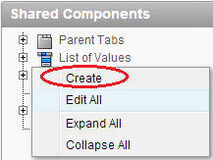
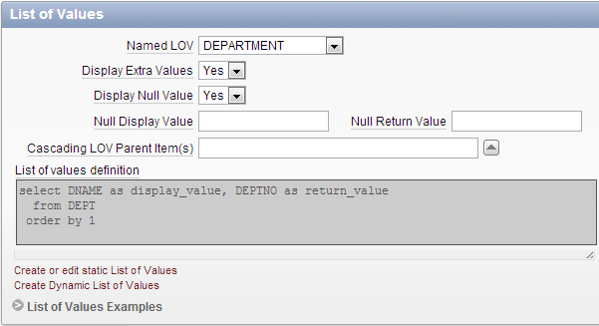
Changing Item Type to LOV
Use one of the two ways
Create dynamic list of values
Create a named LOV for reuse
Create list of values → From scratch
Name: DEPARTMENT
Type: Dynamic
Query:
Use a named LOV
Notes:
--for department list
select DNAME display_value, DEPTNO return_value
from DEPT
order by 1
--for employee list
select EMP_LAST_NAME || ', ' || EMP_FIRST_NAME display_value, EMP_ID return_value
from HT_EMP
order by 1
--Can manager be myself?
select EMP_LAST_NAME || ', ' || emp_first_name display_value, EMP_ID return_value
from HT_EMP
where emp_id != :P6_EMP_ID or :P6_EMP_ID is null
order by 1

Slide 31
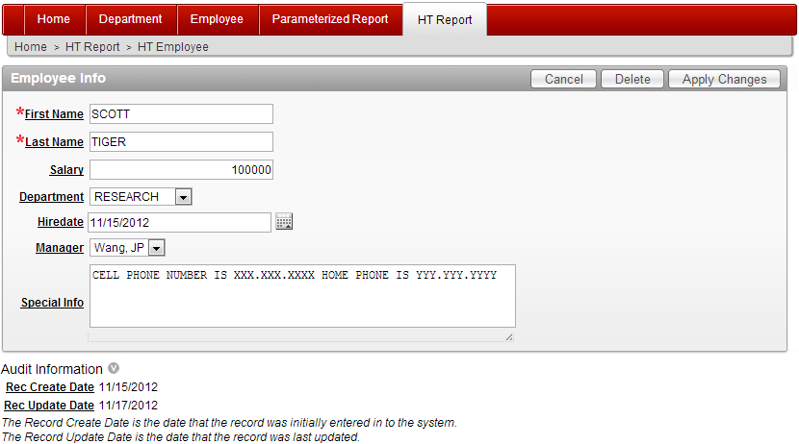
Running Form with LOV

Slide 32
Readings
Application Express Advanced Tutorials
How to control form layout

